Slide 2
Objectives
Further practice at being able to write and amend algorithms for given problems or scenarios using:
Flowcharts
Pseudocode
Program code

Slide 3
Starter
A word is a palindrome if it reads the same forwards and backwards
RACECAR is an example of a palindrome
Create an algorithm using pseudocode to find if a word is a palindrome
R | A | C | E | C | A | R

Slide 4
Starter
Create an algorithm using pseudocode to find if a word is a palindrome
INPUT Word WordLength ← LENGTH(Word) IsPalindrome ← TRUE FOR i ← 0 TO WordLength DO IF Word[i] <> Word[WordLength-i-1] THEN IsPalindrome ← FALSE ENDIF ENDFOR
R | A | C | E | C | A | R

Slide 5
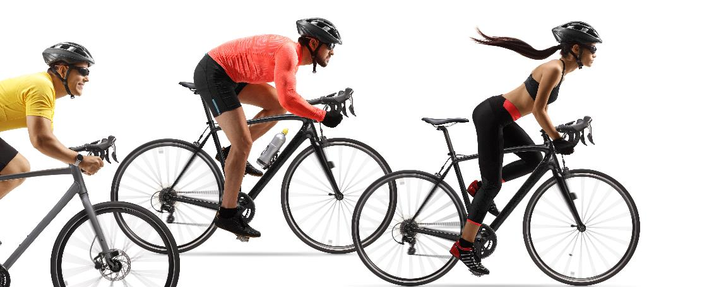
Cycle race
A cycle race has around 10 competitors
At the end of the race, each competitor’s time (in seconds) is entered into a program
The program automatically calculates the fastest time
Work in a pair to create an algorithm for the program using pseudocode

Slide 6
Cycle race
Create an algorithm for the program using pseudocode
fastestTime ← 0 firstInput ← TRUE moreTimes ← TRUE WHILE moreTimes DO INPUT time IF time = -1 THEN moreTimes = FALSE ELSE IF firstInput THEN
fastestTime ← time firstInput ← FALSE ELSE IF time < fastestTime THEN fastestTime ← time ENDIF ENDIF ENDIF ENDWHILE OUTPUT fastestTime

Slide 7
Review flowchart symbols
Work with a partner to decide what each of the following symbols represent in a flowchart
Symbol | Meaning | Symbol | Meaning

Slide 8
Review flowchart symbols
Work with a partner to decide what each of the following symbols represent in a flowchart
Symbol | Meaning | Symbol | Meaning
 | Process |  | Begin or End
 | Input or Output |  | Subroutine
 | Decision

Slide 9
Worksheet 7
Complete Task 1 and Task 2 on Worksheet 7

Slide 10
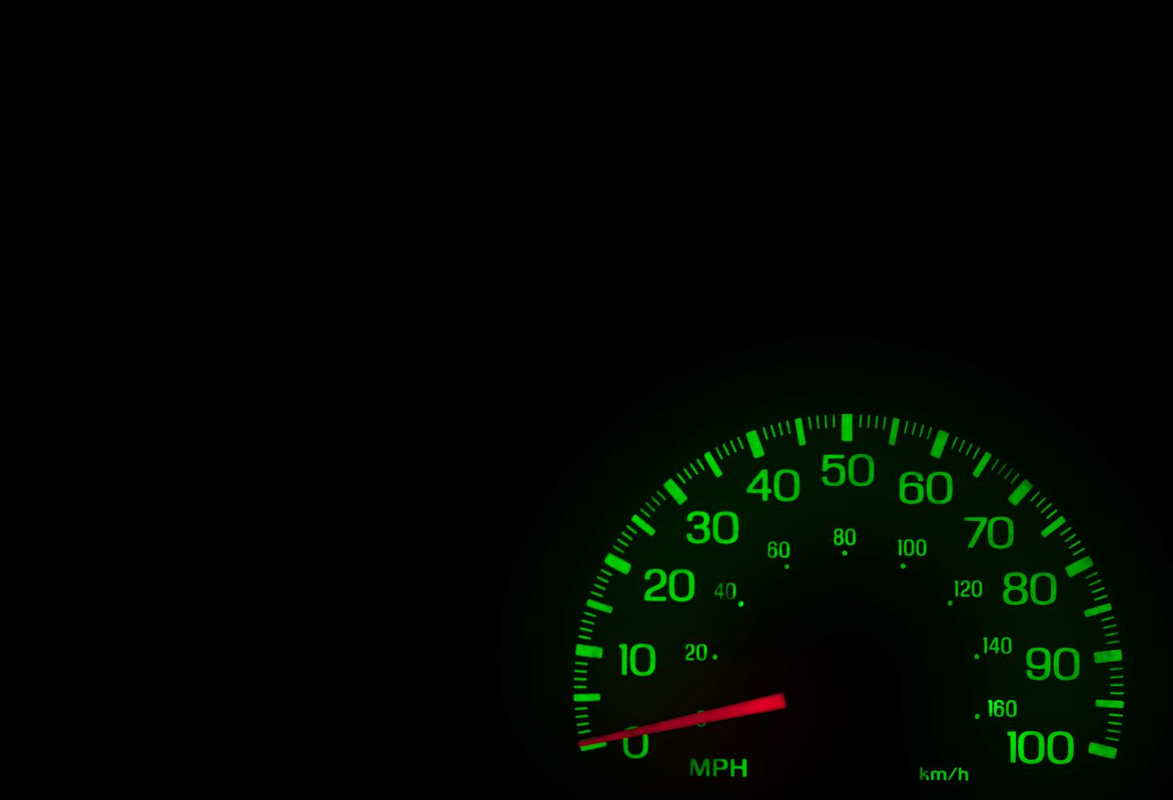
Distance convertor
The following slide shows some programming code written in Python for a MPH (miles per hour) to km/h (kilometres per hour) convertor
The program will only accept miles between 0 and 100
Identify the three errors in the program
Amend the code to fix the errors (you should be able to do this even if you do not know Python)

Slide 11
Distance convertor
Identify the three errors in the program
Amend the code to fix the errors (you should be able to do this even if you do not know Python)
miles = -1 valid = Flse while not valid: mph = float(input("Enter number of miles per hour: ")) if mph >= 0 or mph <= 100: valid = True kmph = 1.609 * mph print(kmph, "km/h)

Slide 12
Distance convertor - errors
Identify the three errors in the program
Amend the code to fix the errors (you should be able to do this even if you do not know Python)
miles = -1 valid = Flse while not valid: mph = float(input("Enter number of miles per hour: ")) if mph >= 0 or mph <= 100: valid = True kmph = 1.609 * mph print(kmph, "km/h)

Slide 13
Distance convertor - corrected
Identify the three errors in the program
Amend the code to fix the errors (you should be able to do this even if you do not know Python)
miles = -1 valid = False while not valid: mph = float(input("Enter number of miles per hour: ")) if mph >= 0 and mph <= 100: valid = True kmph = 1.609 * mph print(kmph, "km/h")

Slide 14
Worksheet 7
Complete Task 3 on Worksheet 7

Slide 15
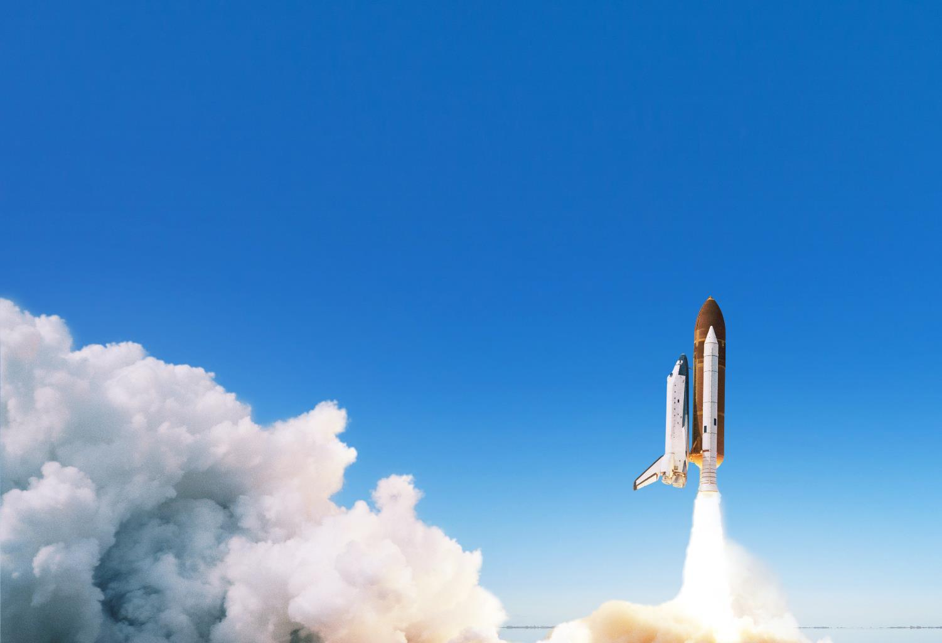

Plenary
Create a countdown for a space shuttle launch
The procedure time.sleep(seconds) will pause a program for a number of seconds
Write an algorithm as a flowchart, pseudocode or program code to produce the countdown from 10 to 0

Slide 16
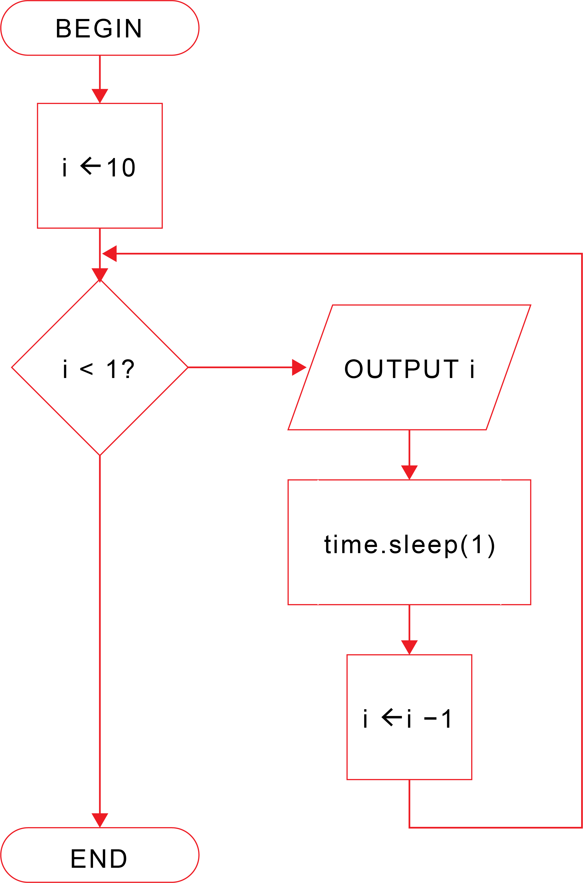
Plenary - flowchart
Create a countdown for a space shuttle launch

Slide 17
Plenary - pseudocode
Create a countdown for a space shuttle launch
FOR i ← 10 TO 1 STEP -1 OUTPUT i time.sleep(1) OUTPUT "Liftoff"

Slide 18
Plenary – program code
Create a countdown for a space shuttle launch
import time for i in range(10,0,-1): print(i) time.sleep(1) print("Liftoff")

